Slide 1
Image Colorization Using cGANs
TEAM MEMBERS:
RESHMI JHA (PUR078BCT066)
MD ASTAFAR ALAM (PUR078BCT049)
RITESH SAHANI (PUR078BCT068)
SUBASH KUMARYADAV (PUR078BCT087)

Slide 2
INTRODUCTION
Image colorization is the process of adding realistic colors to grayscale images, making them visually appealing and more informative. In this project, we utilize Conditional Generative Adversarial Networks (cGANs) to colorize images from Grayscale inputs.
The cGANs model consists of a Generator, which predicts the colorized version by Taking a grayscale image (L channel in LAB space) as input and predicts the missing color channels (A/B), and a Discriminator, which ensures the realism of the generated image.

Slide 3
PROBLEM STATEMENT
Many old and grayscale images lack color information.
Manual colorization is time-consuming and requires expert knowledge.
Need for an automated approach using deep learning.

Slide 4
OBJECTIVE OF THE PROJECT
Develop a cGAN model to colorize grayscale images automatically.
Achieve realistic and visually appealing outputs using a U-Net-based Generator and Patch Discriminator.
Evaluate performance using PSNR (peak signal-to-noise ratio) as metric and analyze generalization on unseen data.

Slide 5
METHODOLOGY
1. Preprocessing :- Convert grayscale images into a suitable format.
2. Training cGAN Model :-Train the generator and discriminator using dataset.
3. Colorization Process :- Generate colorized images.
4. Postprocessing :- Convert the output to a final color image.
5. Evaluation :- Compare results with ground truth images.

Slide 6
cGANs ARCHITECTURE
Generator: Predicts the missing color information.
Discriminator: Evaluates whether the generated colorization is realistic.
Loss Function: Helps improve the model by minimizing errors.

Slide 7
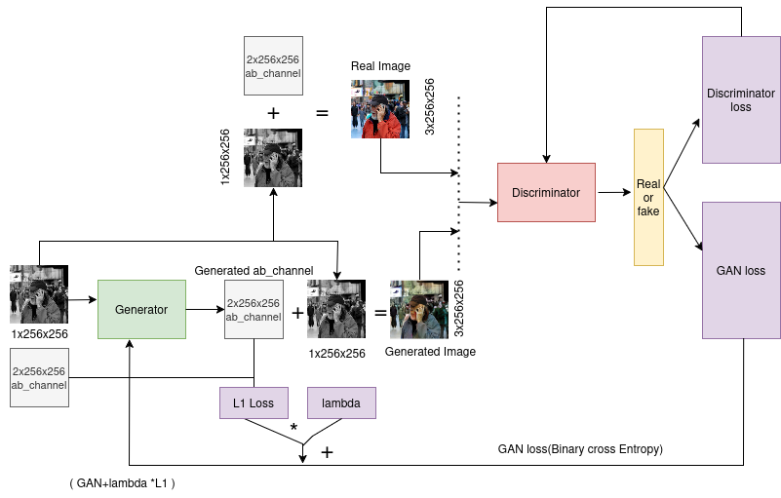
cGANs ARCHITECTURE

Slide 8

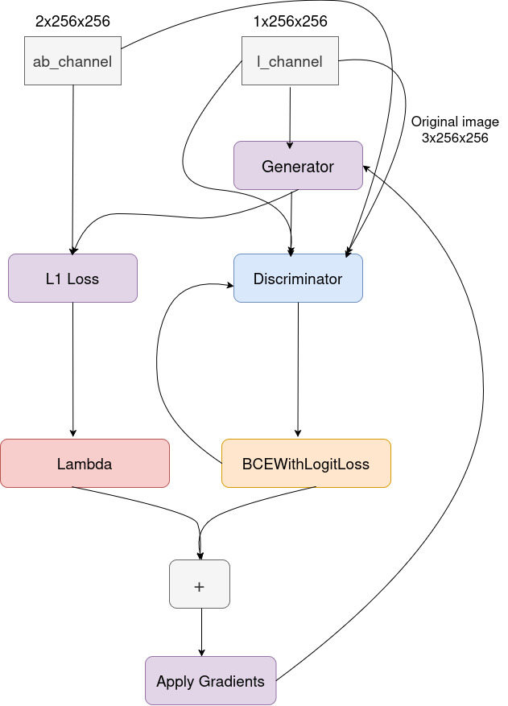
TRAINING PROCESS
Adversarial Training
Loss Functions
Epochs and Batches
The generator and discriminator are trained simultaneously, with the generator trying to produce realistic images while the discriminator attempts to distinguish between real and generated images.
The loss functions for both networks are crucial. The generator aims to minimize the difference between generated and real images, while the discriminator maximizes its ability to differentiate.
The model is trained over multiple epochs with mini-batches to ensure convergence and stability.

Slide 9
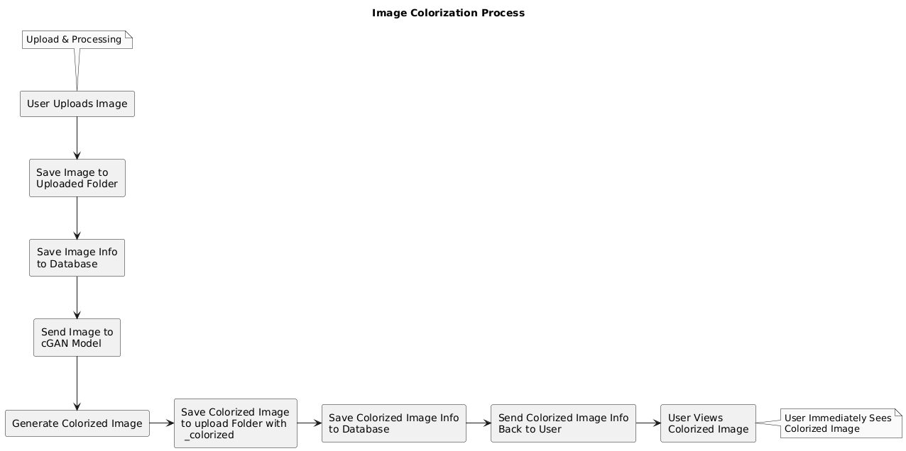
SYSTEM BLOCK DIAGRAM

Slide 10
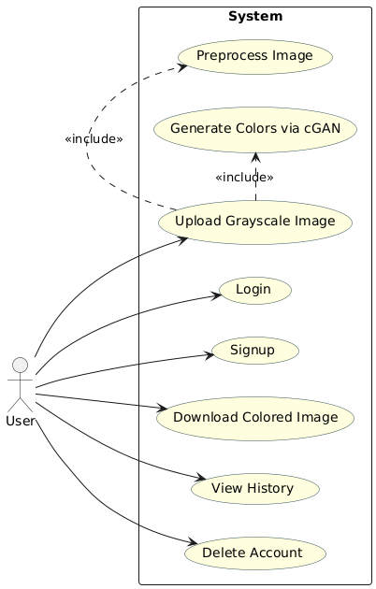
USE CASE DIAGRAM

Slide 11
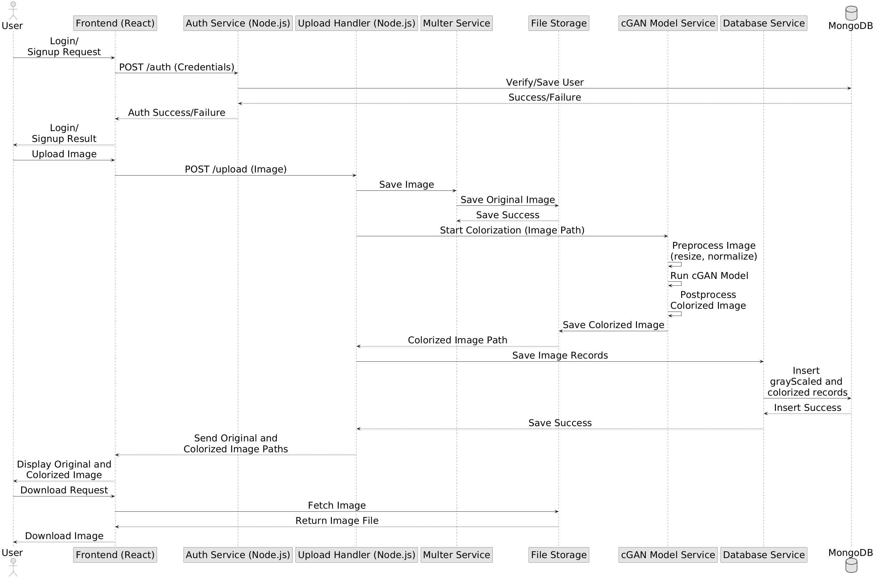
REQUEST RESPONSE DIAGRAM

Slide 12
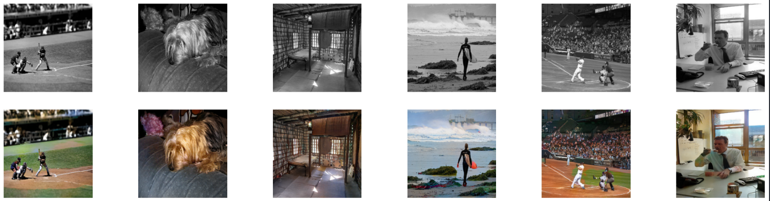
RESULTS

Slide 13
CHALLENGES & SOLUTIONS
Data Availability: Use large datasets to train cGANs effectively.
Computation Power: Optimize model to run on limited hardware.
Accuracy Issues: Fine-tune the model to improve results.

Slide 14
DEMONSTRATION

Slide 15
CONCLUSION AND FUTURE SCOPE
Conclusion: cGAN-based image colorization provides a powerful AI-driven solution.
Future Scope: Enhance model performance using transformer-based approaches.
Deploy the model into a real-world application.

Slide 16
REFERENCES
Phillip Isola, Jun-Yan Zhu, Tinghui Zhou, and Alexei A. Efros, “Image-to-Image Translation with Conditional Adversarial Networks” 2018. [Online]. Available: https://arxiv.org/abs/1611.07004
Richard Zhang, Phillip Isola, and Alexei A. Efros, “Colorful Image Colorization,” 2016. [Online]. Available: https://arxiv.org/abs/1603.08511
H. Zhang, I. Goodfellow, D. Metaxas, and A. Odena, “Self-attention generative adversarial networks,” 2018. [Online]. Available: https://arxiv.org/abs/1805.08318
M. Limmer and H. P. A. Lensch, “Infrared colorization using deep convolutional neural networks,” CoRR, vol. abs/1604.02245, 2016. [Online]. Available: http://arxiv.org/abs/1604.02245
A. Deshpande, J. Lu, M. Yeh, and D. A. Forsyth, “Learning diverse image colorization,” CoRR, vol. abs/1612.01958, 2016. [Online]. Available: http://arxiv.org/abs/1612.01958
Kaiming He , Xiangyu Zhang , Shaoqing Ren , Jian Sun, “Deep Residual Learning for Image Recognition,” 2015. [Online]. Available: http://arxiv.org/abs/1512.03385
Nazeri, Kamyar and Ng, Eric and Ebrahimi, Mehran, “Image Colorization Using Generative Adversarial Networks,” 2018. [Online]. Available: https://arxiv.org/abs/1803.05400

Slide 17
THANK YOU.

